Slide 1
ProgTeam Week 1
Brute Force

Slide 2
What is Competitive Programming?
“Art of Problem Solving”
Find solutions to problems as fast as possible
Solutions must be efficient!

Slide 3
Why Competitive Programming?
Increase knowledge about algorithms
Practice for interviews
Thrill of competitions
It’s fun! <- my favorite reason :)

Slide 4
Week 1: Brute Force
1 2 3 4 5
2 1 3 4 5
2 3 1 4 5
3 2 1 4 5
1 3 2 4 5
3 1 2 4 5
3 2 4 1 5
2 3 4 1 5
2 4 3 1 5
4 2 3 1 5
3 4 2 1 5
4 3 2 1 5
1 3 4 2 5
3 1 4 2 5
3 4 1 2 5
4 3 1 2 5
1 4 3 2 5
4 1 3 2 5
1 2 4 3 5
2 1 4 3 5
2 4 1 3 5
4 2 1 3 5
1 4 2 3 5
4 1 2 3 5
4 2 3 5 1
2 4 3 5 1
2 3 4 5 1
3 2 4 5 1
4 3 2 5 1
3 4 2 5 1
3 2 5 4 1
2 3 5 4 1
…
3 5 2 4 1
5 3 2 4 1
4 3 5 2 1
3 4 5 2 1
3 5 4 2 1
5 3 4 2 1
4 5 3 2 1
5 4 3 2 1
4 2 5 3 1
2 4 5 3 1
2 5 4 3 1
5 2 4 3 1
4 5 2 3 1
5 4 2 3 1
1 4 3 5 2
4 1 3 5 2
4 3 1 5 2
3 4 1 5 2
1 3 4 5 2
3 1 4 5 2
3 4 5 1 2
4 3 5 1 2
4 5 3 1 2
5 4 3 1 2
3 5 4 1 2
5 3 4 1 2
1 3 5 4 2
3 1 5 4 2
3 5 1 4 2
5 3 1 4 2
1 5 3 4 2
5 1 3 4 2
1 4 5 3 2
4 1 5 3 2
4 5 1 3 2
5 4 1 3 2
1 5 4 3 2
5 1 4 3 2
1 2 4 5 3
2 1 4 5 3
2 4 1 5 3
4 2 1 5 3
1 4 2 5 3
4 1 2 5 3
4 2 5 1 3
2 4 5 1 3
2 5 4 1 3
5 2 4 1 3
4 5 2 1 3
5 4 2 1 3
1 4 5 2 3
4 1 5 2 3
4 5 1 2 3
5 4 1 2 3
1 5 4 2 3
5 1 4 2 3
1 2 5 4 3
2 1 5 4 3
2 5 1 4 3
5 2 1 4 3
1 5 2 4 3
5 1 2 4 3
1 2 3 5 4
2 1 3 5 4
2 3 1 5 4
3 2 1 5 4
1 3 2 5 4
3 1 2 5 4
3 2 5 1 4
2 3 5 1 4
2 5 3 1 4
5 2 3 1 4
3 5 2 1 4
5 3 2 1 4
1 3 5 2 4
3 1 5 2 4
3 5 1 2 4
5 3 1 2 4
1 5 3 2 4
5 1 3 2 4
1 2 5 3 4
2 1 5 3 4
2 5 1 3 4
5 2 1 3 4
1 5 2 3 4
5 1 2 3 4
Some problems are small enough that you can search the entire output space
Brute force:
Go through each possible answer and select the optimal one
Important: Have an estimate of the total runtime!
10⁷ ops. per second is “safe”
10⁸ ops. per second is pushing the limit
+10⁹ ops. per second = Find another idea

Slide 5
Ex. 1: Party Lamps [IOI 98]
You are given K (1 <= K <= 100) lamps which initially are either on or off.
There are 3 buttons:
Button 1 toggles lamps 2,4,6,8,....
Button 2 toggles lamps 1,3,5,7,....
Button 3 toggles lamps 1,4,7,10,....
You can hit every button up to N (1 <= N <= 10000) times:
Can you turn all lamps off?

Slide 6
Ex. 1: Party Lamps [IOI 98]
You are given K (1 <= K <= 100) lamps which initially are either on or off.
There are 3 buttons
You can hit every button up to N (1 <= N <= 10000) times:
Can you turn all lamps off?
Bad idea: try every possible combination of hitting each button N times
= 100 · 3¹⁰⁰⁰⁰ operations = much, much too slow
Observation: hitting a button twice is the same as hitting it not at all
Try all combinations of hitting each lamp either zero or one times
= 100 · 2³ operations = very, very safe

Slide 7
Ex. 1: Party Lamps [IOI 98]
You are given K (1 <= K <= 100) lamps which initially are either on or off.
There are 3 buttons
You can hit every button up to N (1 <= N <= 10000) times:
Can you turn all lamps off?
Try all combinations of hitting each lamp either zero or one times
= 100 · 2³ operations = very, very safe
Can calculate using binary numbers
for(int i = 0; i < (1 << 3); i++){
//reset to original state here
for(int j = 0; j < 3; j++){ if((i >> j) & 1){ // Java users: ((1 >> j) & 1) != 0
//toggle button ‘j’ here
}
}
//test if all lamps are off here
}

Slide 8
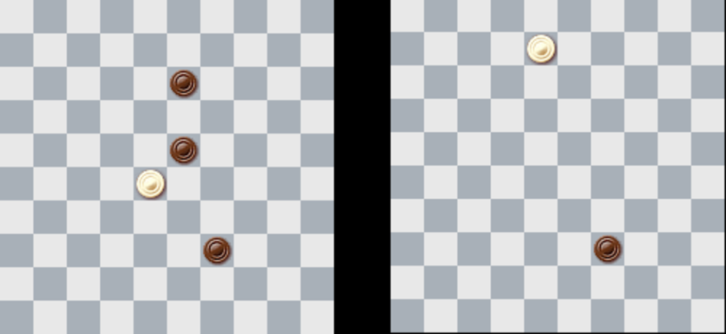
Ex. 2: Draughts [CERC 2013]
We are given a 10x10 checkerboard with White and Black pieces. We will play as white.
A piece can “capture” another piece by jumping over it, if the next square is empty, immediately removing the piece from the board.
We can chain together jumps if every jump is valid
What is the maximum number of captures?

Slide 9
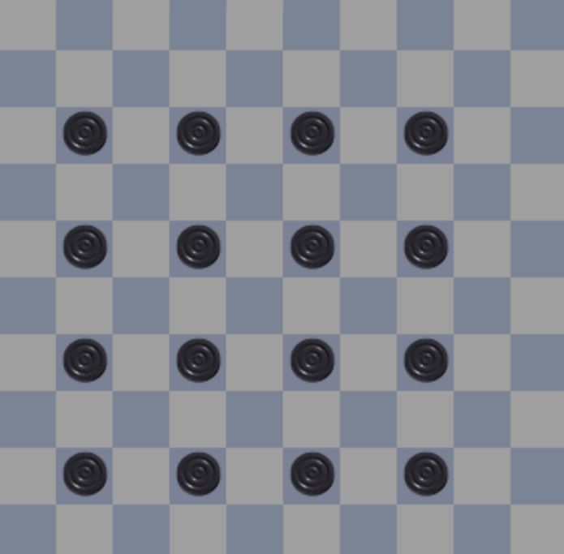
Ex. 2: Draughts [CERC 2013]
We are given a 10x10 checkerboard with White and Black pieces. We will play as white.
We can chain together jumps if every jump is valid
What is the maximum number of captures?
“Backtracking and hope it’s fast enough...or prove it”
Every move will move us by 2 pieces:
We can only capture 16 possible pieces
Each move has 3 possible moves after
(We can’t go backwards)
= 3¹⁶ moves ~= 4 · 10⁷ operations
Since this is a strict upper bound, should be safe with good enough implementation

Slide 10
Ex. 2: Draughts [CERC 2013]
What is the maximum number of captures in a checkers/draughts game?
Backtracking = 3¹⁶ moves
Backtracking: recursively explore every possible path:
int dx[] = {-1, -1, 1, 1}, dy[] = {-1, 1, -1, 1}; //useful to keep moves in array
//so we don’t have to write out each one individually
int search(int x, int y){
int ans = 0;
for(int i = 0; i < 4; i++){
int adj_square_x = x + dx[i], adj_square_y = y + dy[i];
int new_x = x + 2 * dx[i], new_y = y + 2 * dy[i];
if(in_bounds(new_x,new_y) && /*adj. is opponent*/ && /*dest. is empty*/){
/*empty adjacent square*/
ans = max(ans, 1 + search(new_x, new_y));
/*fill adjacent square back in*/
}
}
return ans;
}

Slide 11
Final Notes
Some types of problems strongly suggest a brute force approach
Sudoku/filling-a-puzzle problems
NP-Complete Problems
Subset sum, Hamiltonian paths, Travelling Salesman, Minimum Graph coloring
N <= 20 will usually have a brute force approach
Pruning a brute force problem can be extremely helpful-or not matter much at all
Depends on how good your heuristic is
Brute-force can be helpful on non-brute-force problems
Usually easier to prove correct than alternate approaches
It’s a good idea to know brute-force implementations in competition settings or interviews

Slide 12
Problem Overview
A - Odd Gnome
B - Alphabet Animals
C - Virus
D - Font
E - Tight-fit Sudoku
F - Infiltration
G - Antiques
Easier
Medium
Challenging
Hard

